Slide 1
Dynamic Business Dashboard Analysis
Customer Sales & Performance Insights

Slide 2
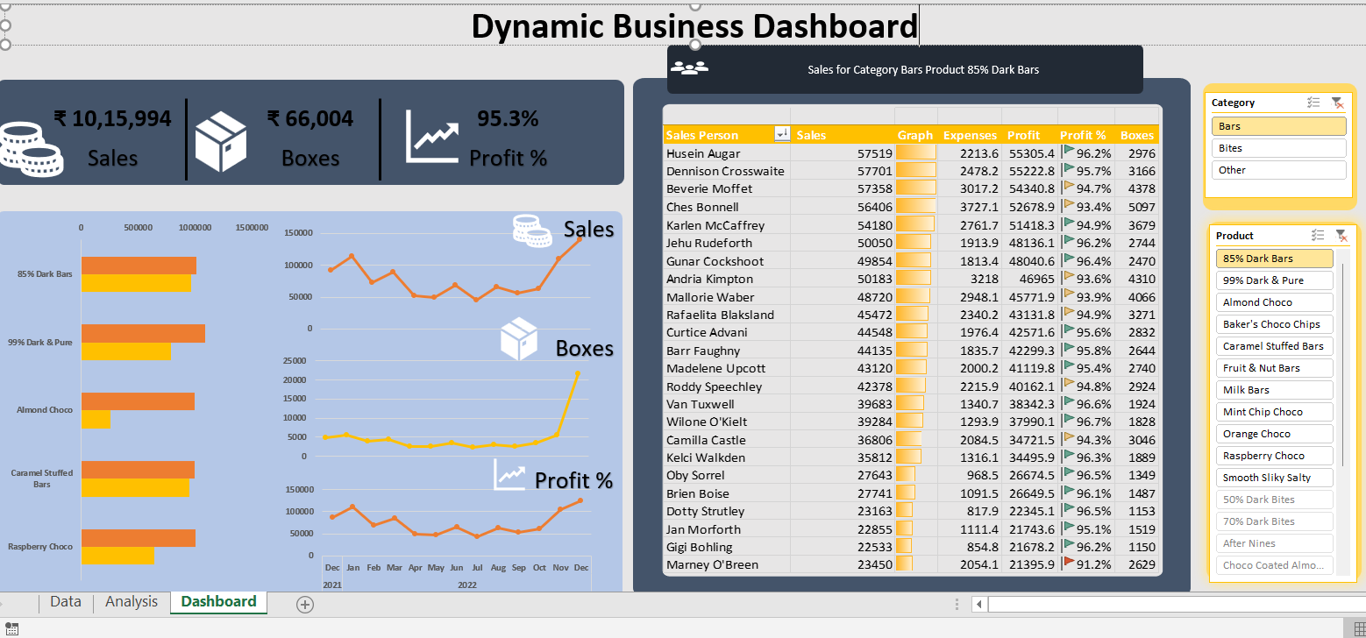
Dashboard Overview

Slide 3
Executive Summary
Total Sales: ₹ 2,17,01,722
Total Boxes: 1344574
Profit Margin: 67.5%
High-margin business with strong performance, but variation across products and salespersons.

Slide 4
Product Performance Insights
Top Performers: 99% Dark & Pure, 85% Dark Bars
Mid: Almond Choco, Caramel Stuffed Bars
Low: Raspberry Choco
Insight: Premium products drive revenue.

Slide 5
Key Problems
Overdependence on few products
Underperforming SKUs
Seasonal sales dependency

Slide 6
Recommendations
Expand premium product line
Incentivize sales team
Bundle low-performing products
Plan campaigns before peak season

